Slide 1



SGP-III
M D HOSTEL WEBAPP
Mentor :- Dr. Amit Thakkar
-Vaidehi Ghodasara (21cs011)

Slide 2
OBJECTIVE
The objective of the website is to provide a comprehensive and secure platform for user registration, login, and profile management, including features such as room booking and password updates, while allowing the admin to manage courses, rooms, and monitor user activities for a seamless and efficient user experience in a hostel or similar environment.

Slide 3
PURPOSE
The purpose of the website is to provide a comprehensive platform for managing and facilitating user registration, user login, and admin functionalities for a hostel or accommodation facility. Users can register, update their profiles, change passwords, and book rooms, while the admin can manage courses, rooms, and access user activity logs to efficiently oversee and operate the accommodation service.

Slide 4
SCOPE
The scope of the website includes providing user registration and login functionalities with extensive validation checks, allowing users to manage their profiles, change passwords, and book hostel accommodations. It also offers an admin login with course and room management capabilities, as well as access to user activity logs for monitoring and managing user interactions on the platform.

Slide 5



TECH STACK

Slide 6
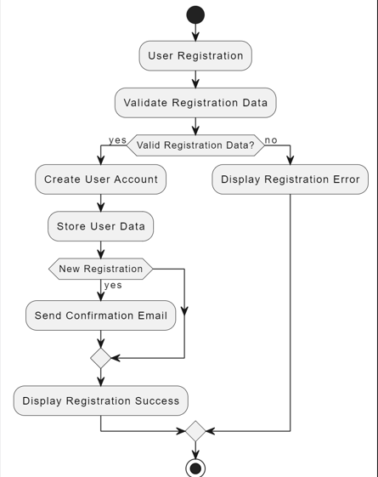
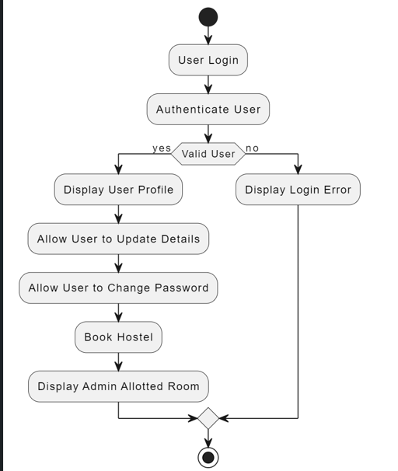
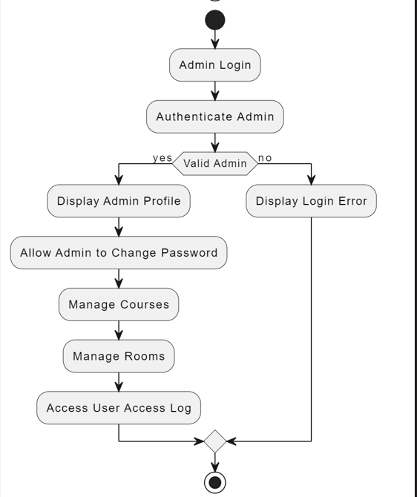
FLOW CHART

Slide 7
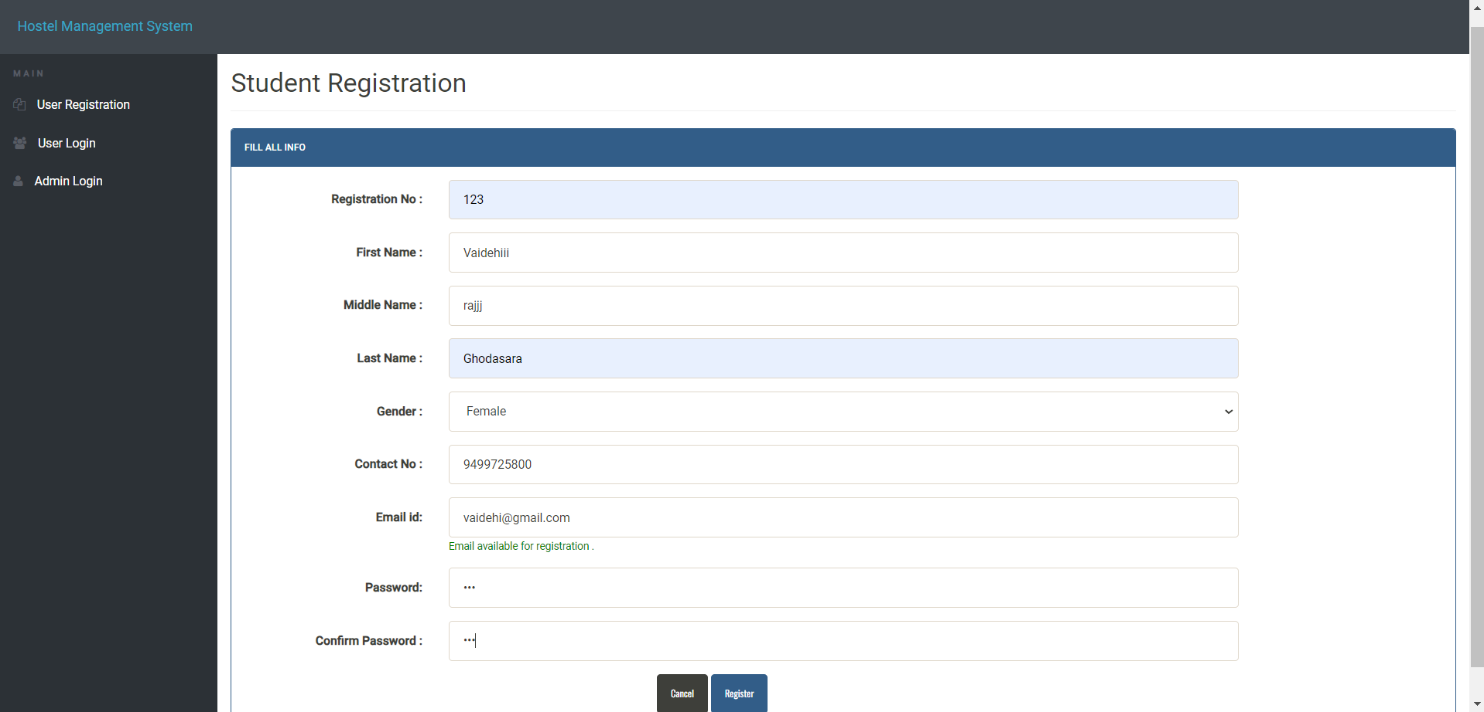
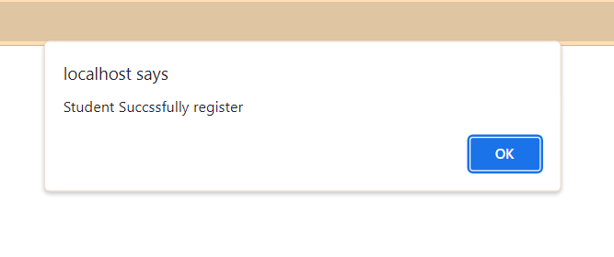
Dashboard for New User
Registration Successful message

Slide 8
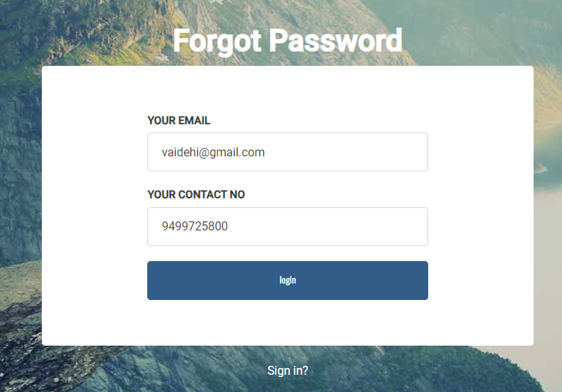
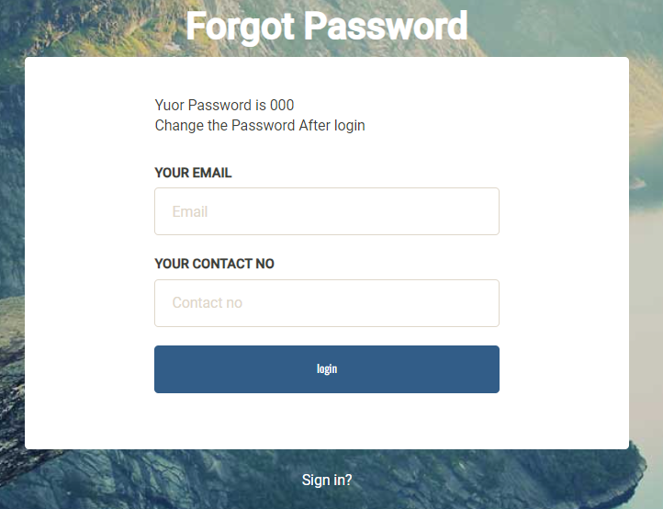
FORGET PASSWORD

Slide 9
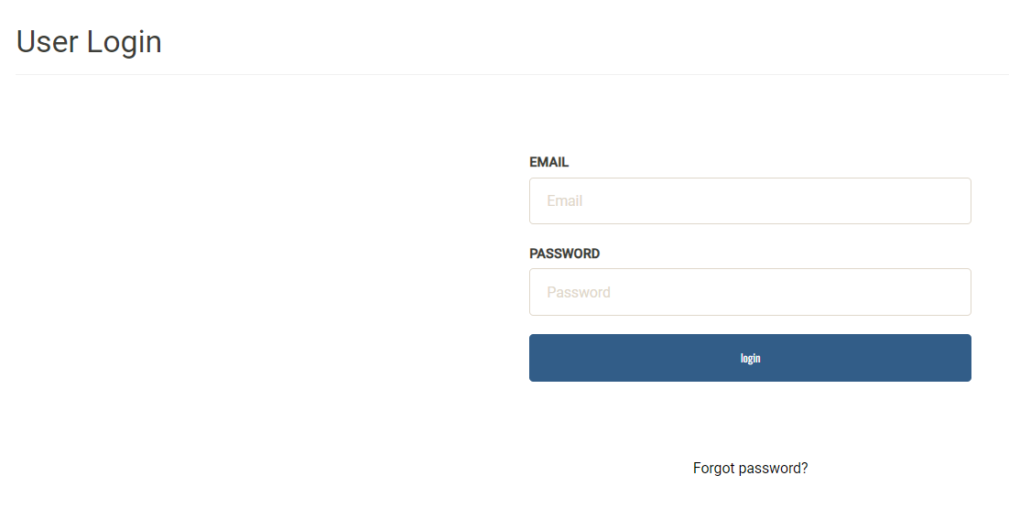
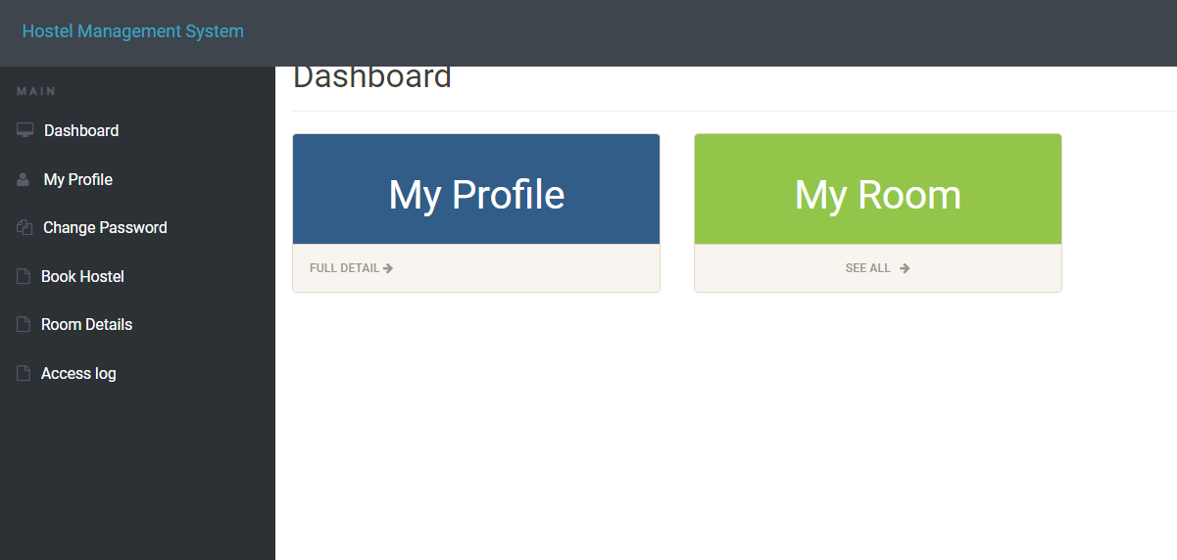
USER LOGIN

Slide 10
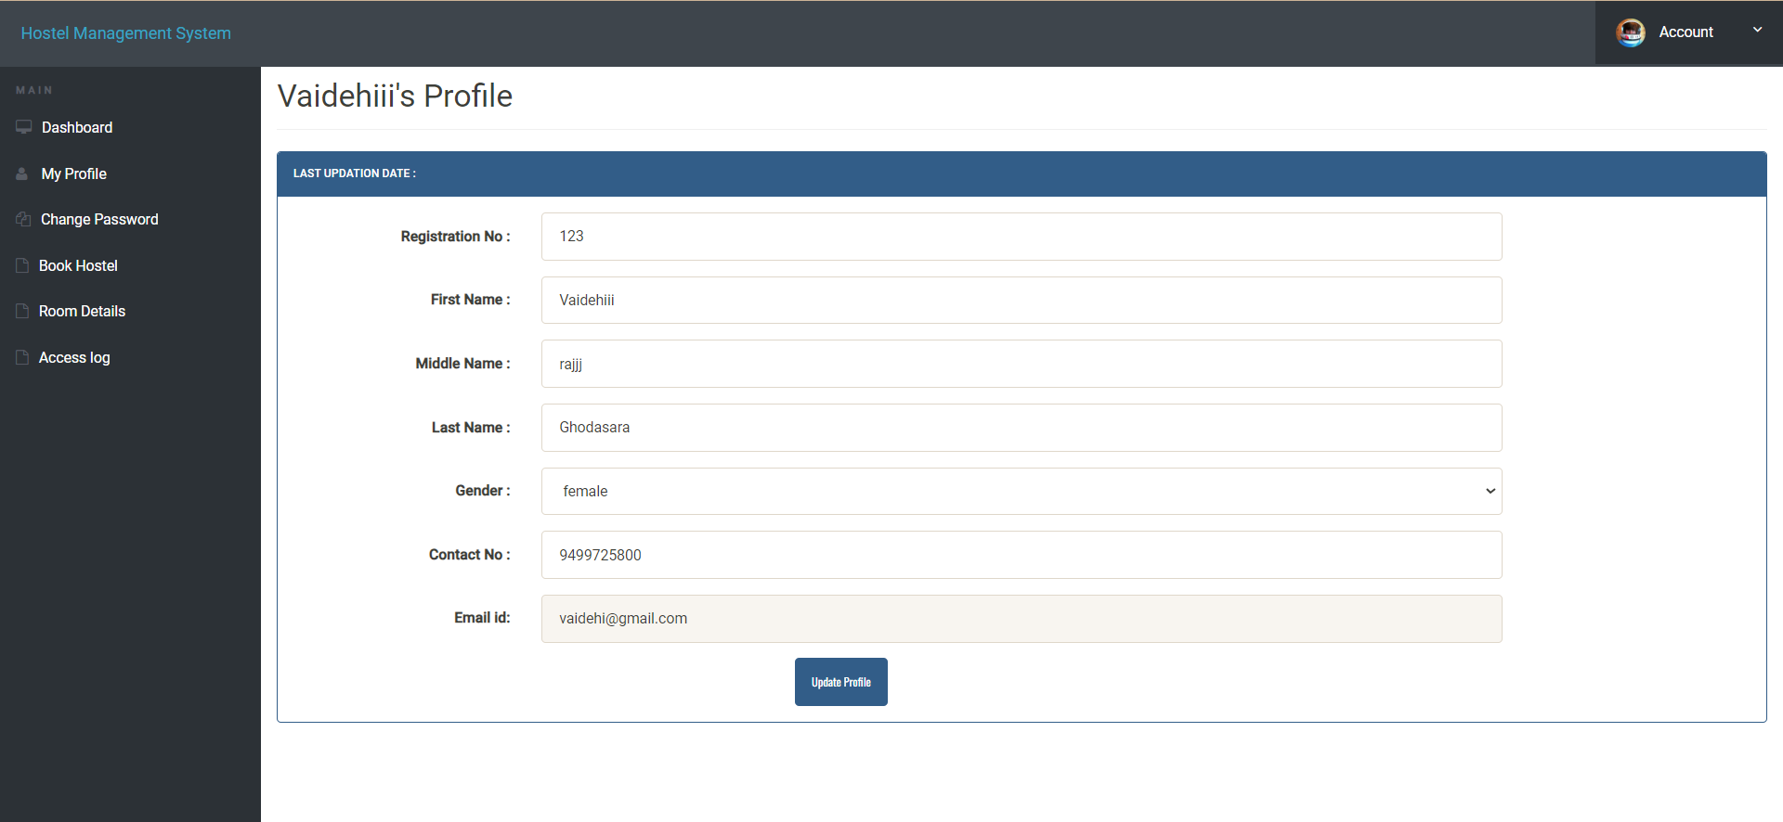
USER PROFILE UPDATE SECTION

Slide 11
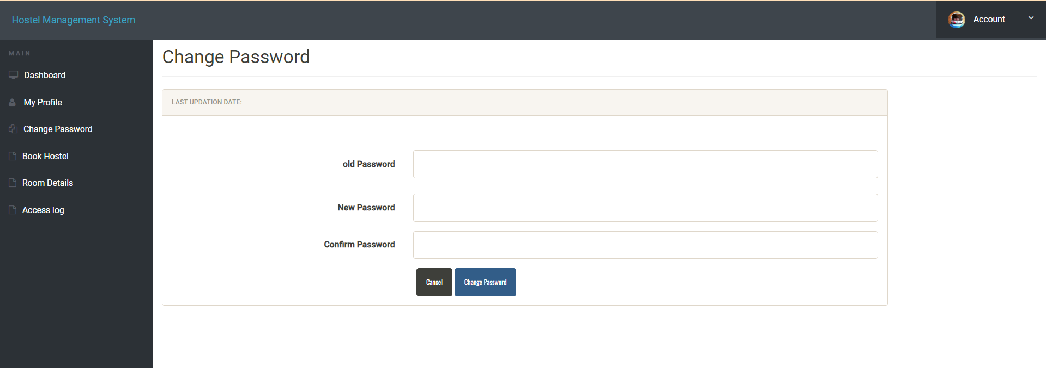
USER PASSWORD UPDATE SECTION

Slide 12
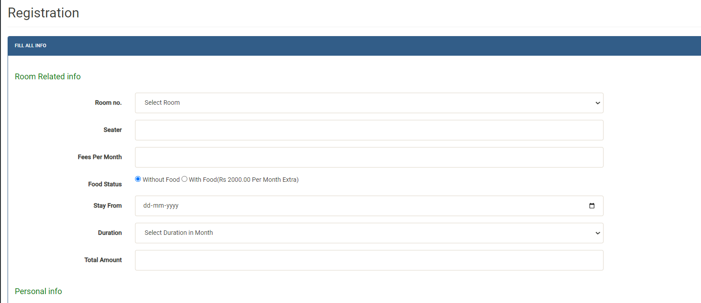
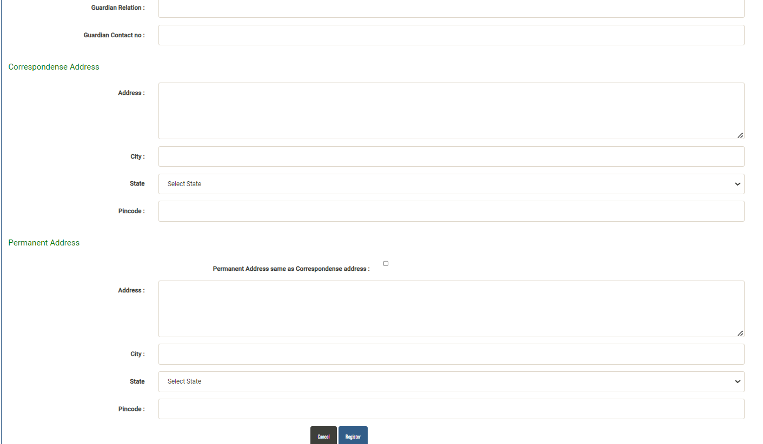
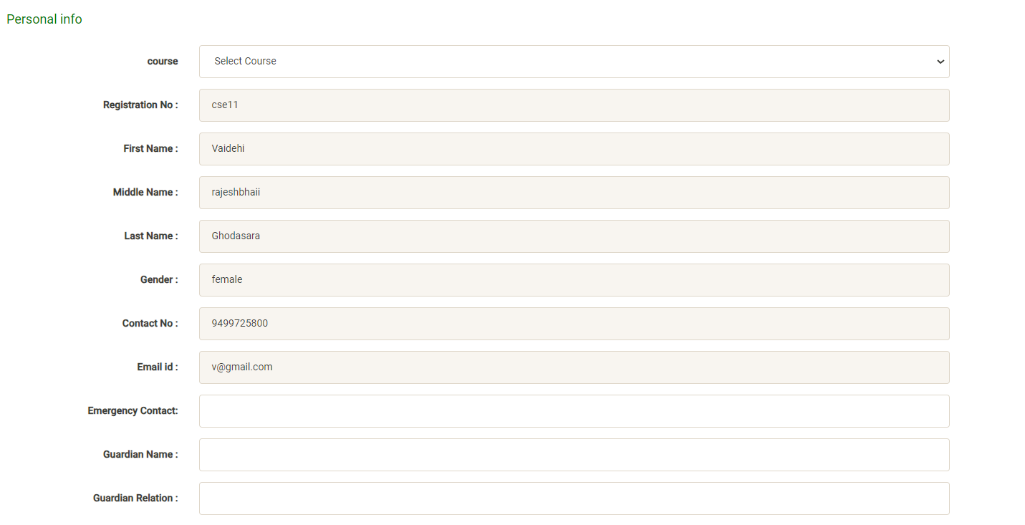
USER REGISTRATION FORM

Slide 13
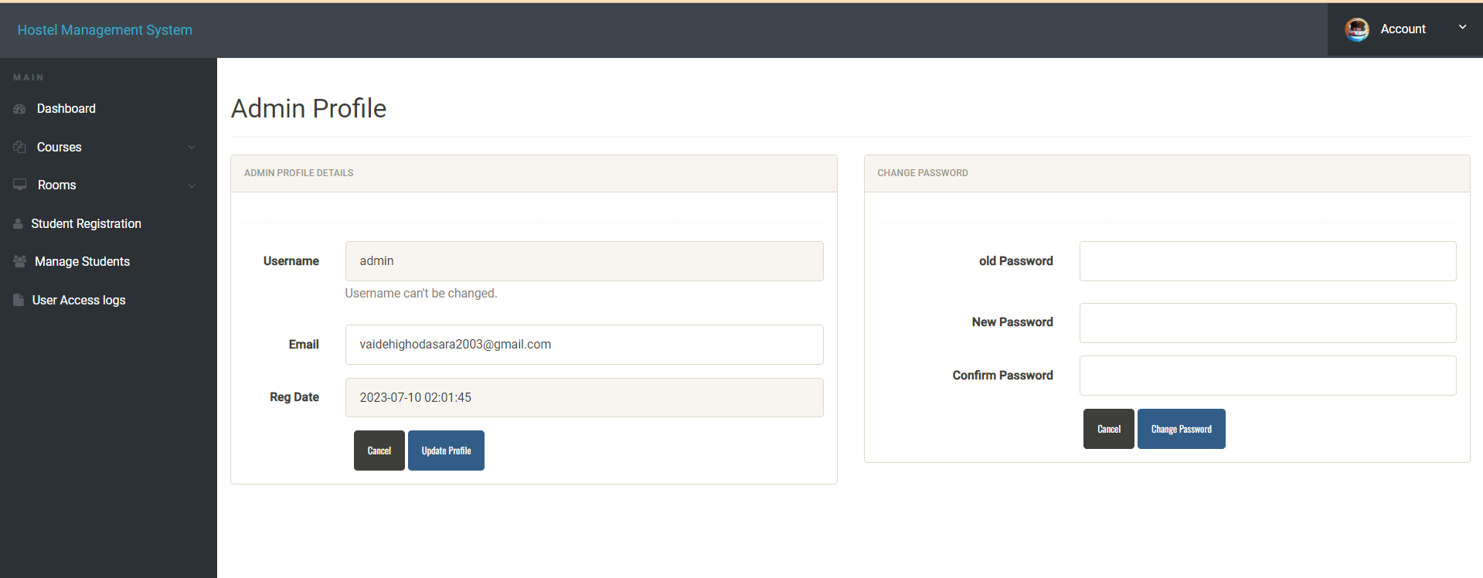
ADMIN DASHBOARD

Slide 14
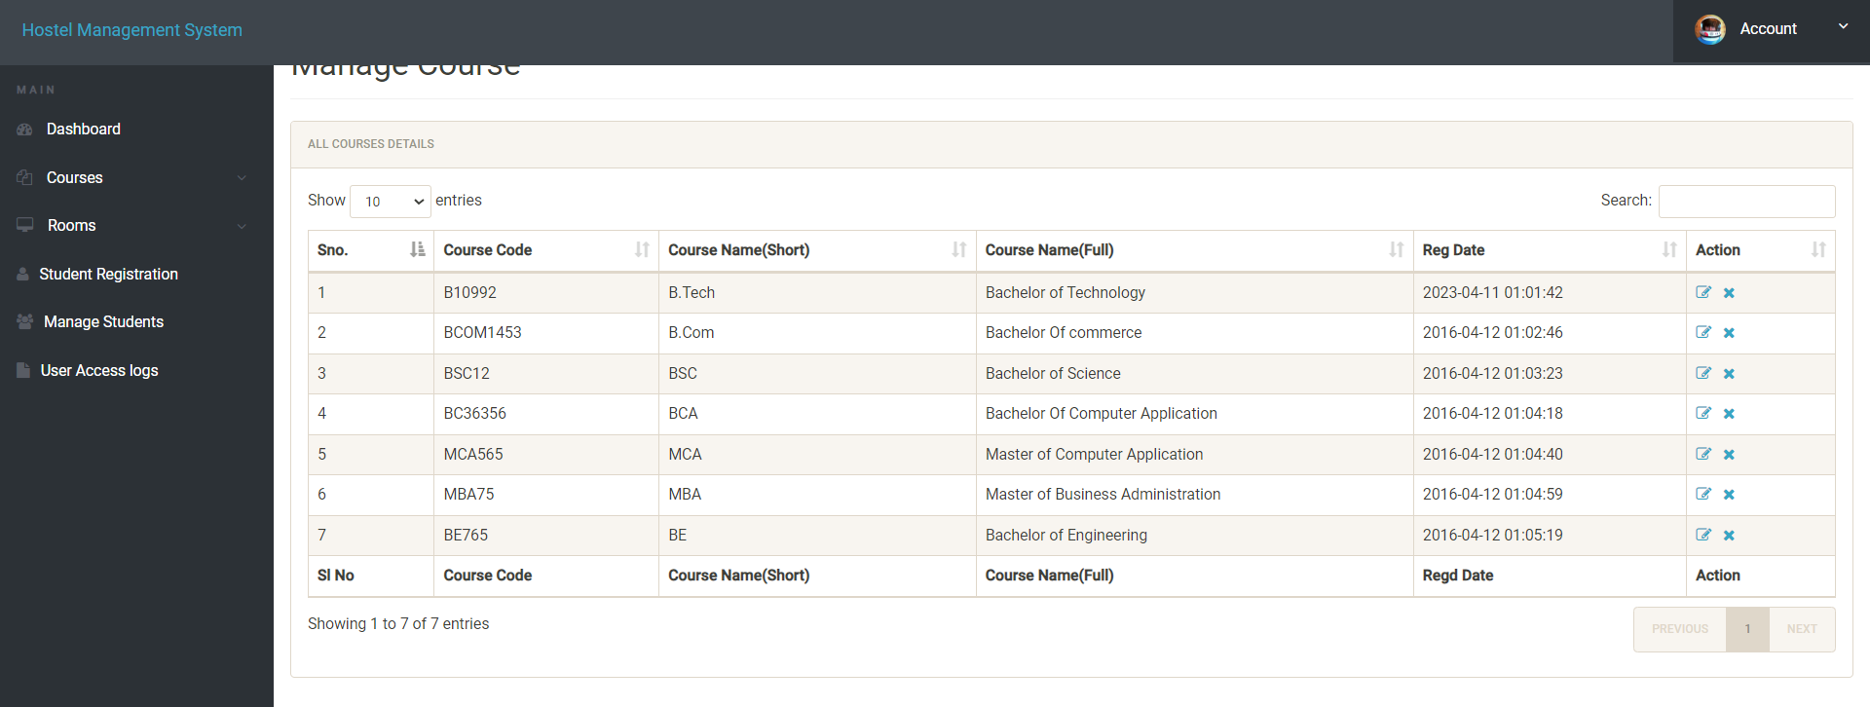
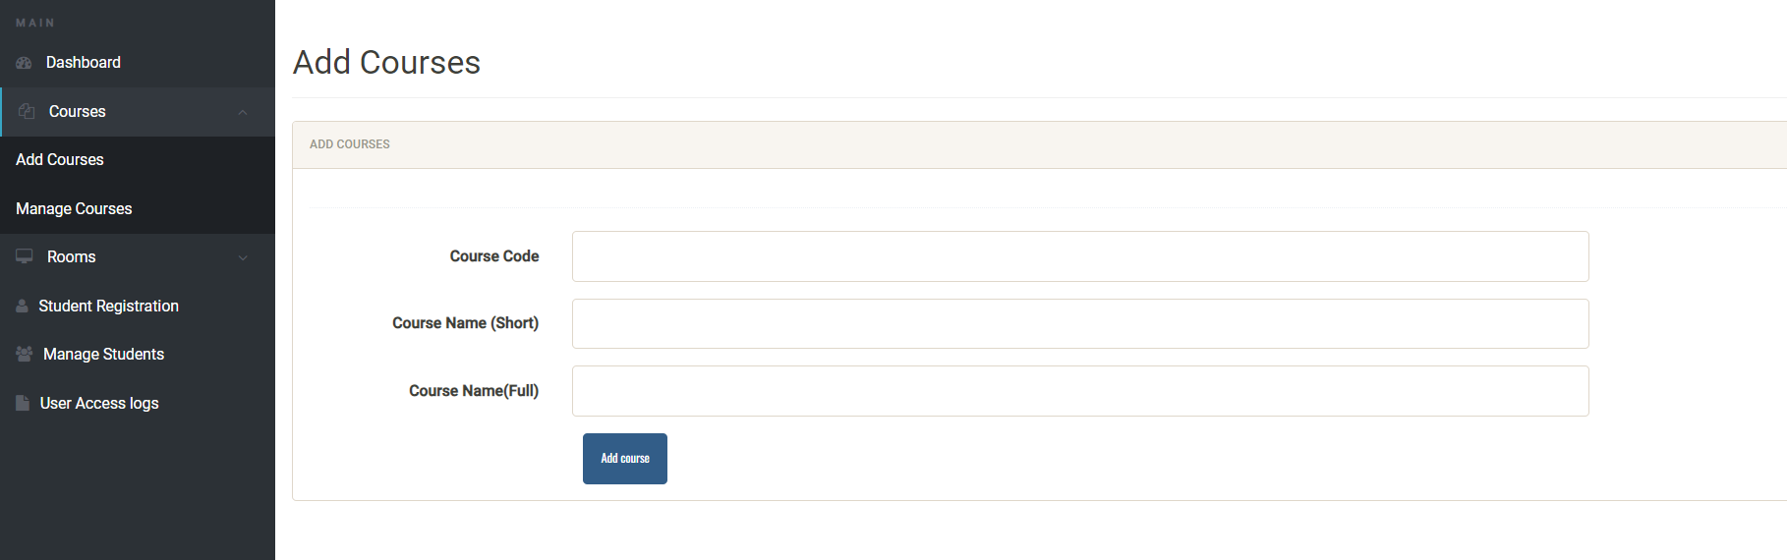
COURSES
Existing Courses
Admin can add courses

Slide 15
ADMIN REGISTORS STUDENT

Slide 16
THANK YOU !

